Slide 1
Parallelizing Dijkstras Algorithm
By Mark, Taylor, Tim, and Zach

Slide 2
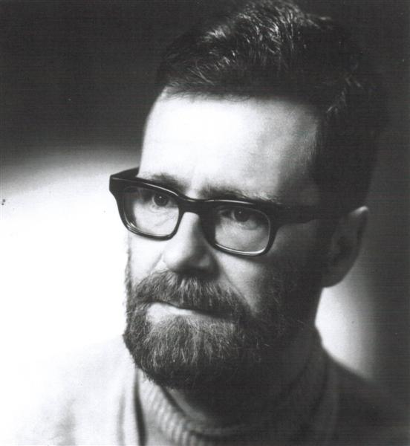
The Man, The Myth, The Legend

Slide 3
Brief overview of Dijkstra’s Algorithm
Finds the shortest path from the start node to every other node
Dijkstra’s algorithm has been used in the past to simplify city transportation routes and maps.
Dijkstra’s run time is O(M*N)

Slide 4
Our version
We chose Dijkstras because we were familiar with the algorithm.
We decided to find the shortest path from one node to all other nodes for every node.
Our run time is O(M*N^2)

Slide 5
Benefits of Parallelization
Makes it faster
Allows for larger problem sets to be solved
Frees up more compute power to be tasked elsewhere

Slide 6
How we parallelized it
We are using Python multiprocessing to parallelize Dijkstra’s algorithm

Slide 7
Serial results

Slide 8
Parallel results

Slide 9
Wrap up

